Slide 1
Data Cleaning / Curation
Notes:
Today we’ll run an exercise on one some dirty data.

Slide 2
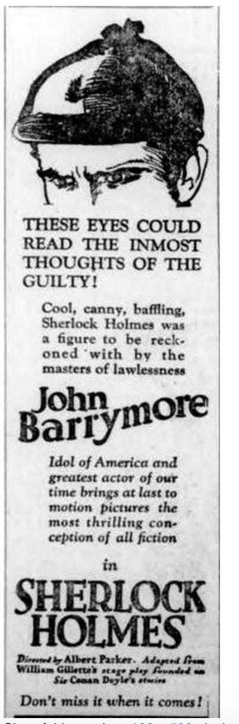
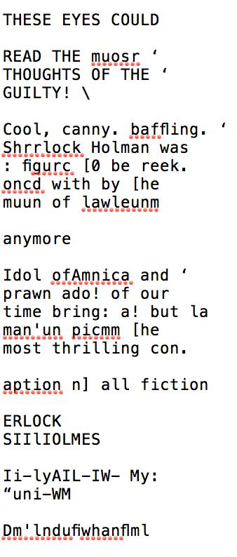
Optical Character Recognition (OCR)
Notes:
What is OCR? What is the relationship between these two images? Why are computers bad at converting image to text?
We’re going to have you engage with these a little.

Slide 3
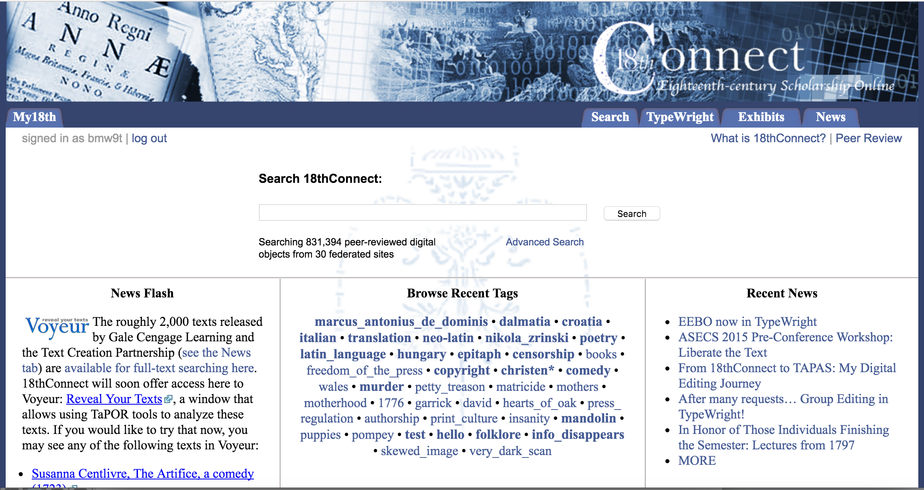
18thConnect
Notes:
Say what 18thconnect is

Slide 4
TypeWright
http://www.18thconnect.org/typewright/documents
Search for “Moll Flanders”
Click “Edit” for the first entry
Will have to make an 18th Connect Account
Assign everyone to two pages
Notes:
Go here, search for this, make an account etc.

Slide 5
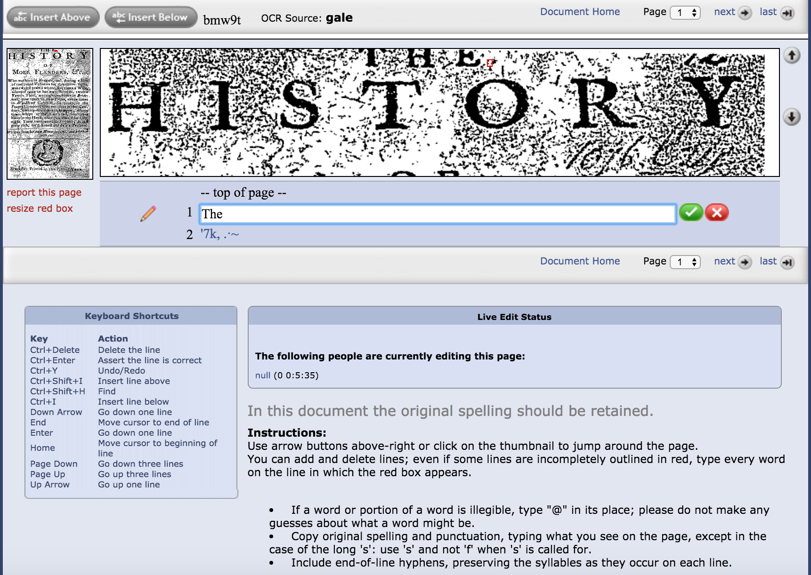
TypeWright
Notes:
Will zero in on a text’s line
Will show what the computer thinks is there
Correct it to what it should be.
Hit the green arrow.
Follow instructions for moving forward.
At the end of this process, the free text is made available back to the subscribers who made the image available. Now, you can actually search the full text of the articles for the first time. But is this a good thing? In one sense obviously.

Slide 6
Canon
What are some books that are important?
Notes:
Basically the point of the next slides are to get them to see that it’s a circle.
We preserve things because they have value.
But value is a social construction. So it means that things get left behind

Slide 7
Canon
What are some books that are important?
How do we show that they are important?

Slide 8
Canon
What are some books that are important?
How do we show that they are important?
Who decided that they were important?

Slide 9
Canon
What are some books that are important?
How do we show that they are important?
Who decided that they were important?
What should be digitized and archived?

Slide 10
Canons
Formed by complicated social formations
Digital archiving can reinforce those formations
We archive what we think is important
So much gets left out – majority of texts are unread, unpreserved, undigitized. And we never know what was in them.
Particularly a problem for “low-brow” writings and works by women and people of color.

